Slide 1

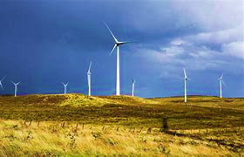
Wind Energy Forecasting: Case Study From Ireland
Mentee: Marisely Urdaneta
Mentor: Silali Banerjee
Mentor Assistant: Renaisa Wahed
November 06, 2022

Slide 2
Content
Introduction
Theoretical Basis
Methodology
Application
Conclusion
Wind Energy Forecasting: Case Study From Ireland
Mentee: Marisely Urdaneta/ Mentor: Silali Banerjee/ Mentor Assistant: Renaisa Wahed

Slide 3
Introduction
Nowadays, many worldwide energy companies are committed to developing green transition for sustainability, the goal in reducing their CO2 footprint which support the Paris Agreement and policies that relies on net zero, reducing, and cutting greenhouse gas emissions from fuel generation power.
According to the International Energy Agency (IEA, 2022) “Increased use of coal was the main factor driving up global energy-related CO2 emissions by over 2 billion tons, their largest ever annual rise in absolute terms”.
“Renewable energy sources and nuclear power provided a higher share of global electricity generation than coal in 2021. Renewables-based generation reached an all-time high, exceeding 8000 terawatt-hours (TWh) in 2021, a record 500 TWh above its 2020 level. Output from wind and solar PV increased by 270 TWh and 170 TWh, respectively, while hydro generation declined due to the impacts of drought, notably in the United States and Brazil”.
“In Ireland, the growth in energy demand for the next ten years varies between 23% in the low demand scenario, to 47% in the high scenario.” according to the Eirgrid All-Island Generation Capacity Statement 2019–2028.
This study aims to provide a meaningful insight from wind electricity generation forecasting in Ireland to prevent losing wind energy every year using data science methodology specifically machine learning tools. It is based on https://github.com/CA683-Group99/Wind-Energy-Prediction.
Wind Energy Forecasting: Case Study From Ireland
Mentee: Marisely Urdaneta/ Mentor: Silali Banerjee/ Mentor Assistant: Renaisa Wahed

Slide 4
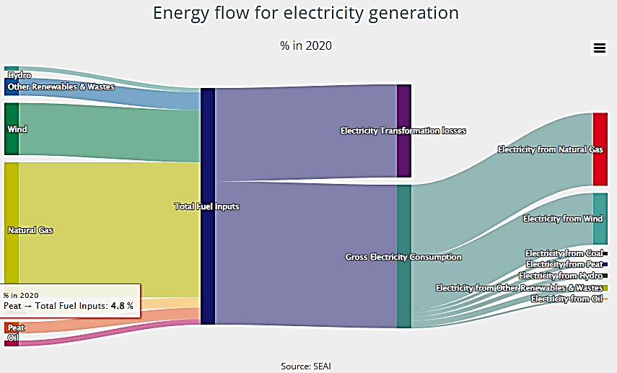
Theoretical Basis
Electricity is the flow of electrical power or charge. The electricity that we use is a secondary energy source because it is produced by converting primary sources which are renewable or nonrenewable energy such as coal, natural gas, nuclear energy, solar energy, and wind energy, into electrical power.
Wind Energy Forecasting: Case Study From Ireland
Mentee: Marisely Urdaneta/ Mentor: Silali Banerjee/ Mentor Assistant: Renaisa Wahed

Slide 5
Methodology
The Problem
Understanding the Data
Data Wrangling
EDA
Python Packages for Data Science
Pre-processing Data in Python
Descriptive Statistics
Importing, Merging, and Exporting Data in Python
Dealing with Missing Values in Python
Correlation-Statistics
Visualization
Model: Fitting, Prediction, and Evaluation
Cross-sectional variables
Time Series Depends on stationarity (Autoregressive, moving average, ARIMA)
Wind Energy Forecasting: Case Study From Ireland
Mentee: Marisely Urdaneta/ Mentor: Silali Banerjee/ Mentor Assistant: Renaisa Wahed

Slide 6


Application: The Problem
In Ireland, generation efficiency of electricity transformation losses accounted for 39.3% of all fuel inputs in 2020. This means that 60.7% of all the energy used to generate electricity ends up as electricity. However, wind electricity generation exceeds the 70% demand in certain hours per day causing wind energy lost and an unbalanced grid.
Balanced Grid
Electricity supply
Demand
Wind Energy Forecasting: Case Study From Ireland
Mentee: Marisely Urdaneta/ Mentor: Silali Banerjee/ Mentor Assistant: Renaisa Wahed

Slide 7
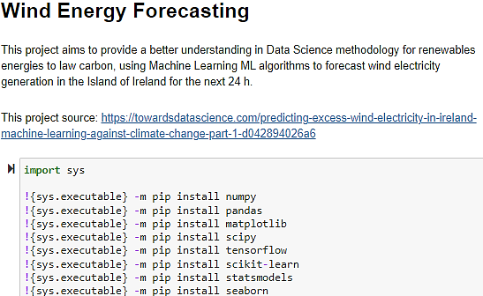






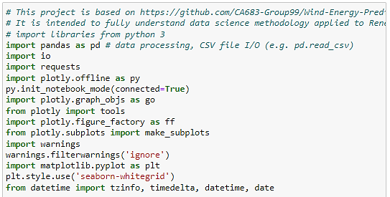




Application: Understanding the Data
Python Packages for Data Science
Installing and Importing Libraries
Wind Energy Forecasting: Case Study From Ireland
Mentee: Marisely Urdaneta/ Mentor: Silali Banerjee/ Mentor Assistant: Renaisa Wahed

Slide 8
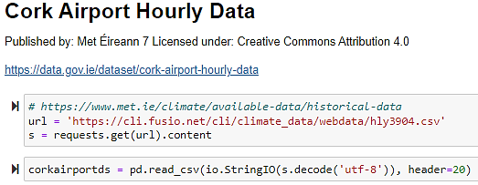
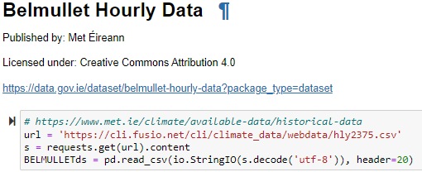
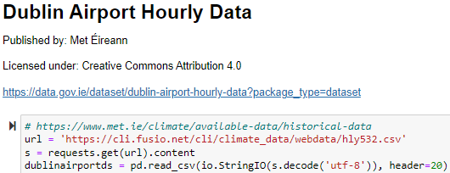
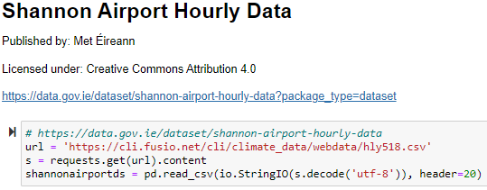
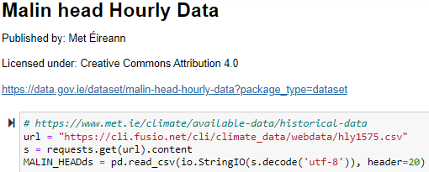
Application: Understanding the Data
Importing, Merging, and Exporting Climate Data in Python
Importing Climate Data using Jupyter Notebook in file 1_weather_dataprep.py
Wind Energy Forecasting: Case Study From Ireland
Mentee: Marisely Urdaneta/ Mentor: Silali Banerjee/ Mentor Assistant: Renaisa Wahed

Slide 9
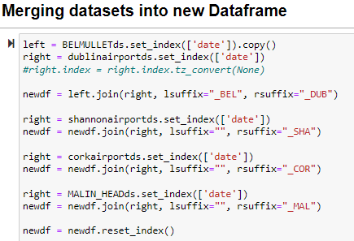
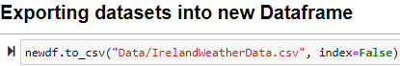
Application: Understanding the Data
Importing, Merging, and Exporting Climate Data in Python
Wind Energy Forecasting: Case Study From Ireland
Mentee: Marisely Urdaneta/ Mentor: Silali Banerjee/ Mentor Assistant: Renaisa Wahed

Slide 10
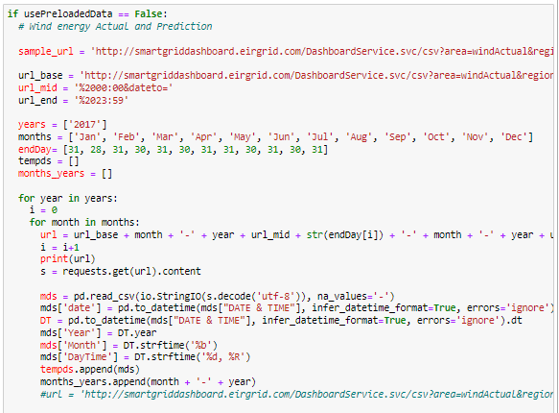
Application: Understanding the Data
Importing, Merging, and Exporting Wind Actual and Forecast Generation Data in Python
Importing Wind Actual and Forecast Generation from Eirgrid http://smartgriddashboard.eirgrid.com/
2017-2022
Wind Energy Forecasting: Case Study From Ireland
Mentee: Marisely Urdaneta/ Mentor: Silali Banerjee/ Mentor Assistant: Renaisa Wahed

Slide 11
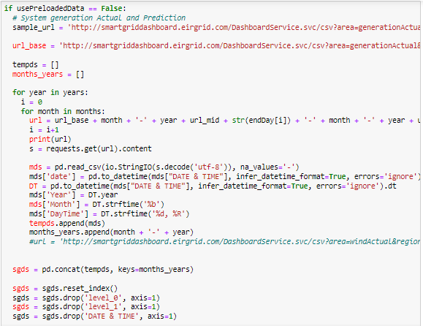
Application: Understanding the Data
Importing, Merging, and Exporting System Actual and Forecast Generation Data in Python
Importing System Actual and Forecast Generation from Eirgrid http://smartgriddashboard.eirgrid.com/
2017-2022
Wind Energy Forecasting: Case Study From Ireland
Mentee: Marisely Urdaneta/ Mentor: Silali Banerjee/ Mentor Assistant: Renaisa Wahed

Slide 12
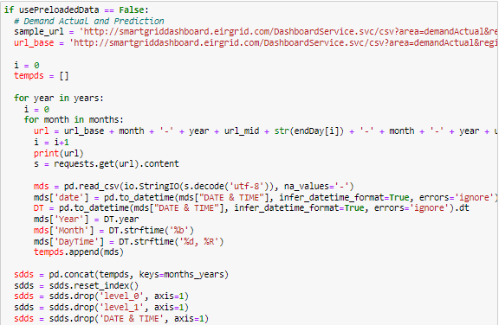
Application: Understanding the Data
Importing, Merging, and exporting Demand Actual and Forecast Generation Data in Python
Importing Demand Actual and Forecast Generation from Eirgrid http://smartgriddashboard.eirgrid.com/
2017-2022
Wind Energy Forecasting: Case Study From Ireland
Mentee: Marisely Urdaneta/ Mentor: Silali Banerjee/ Mentor Assistant: Renaisa Wahed

Slide 13
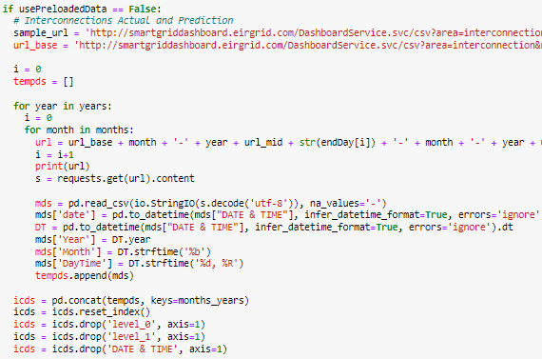
Application: Understanding the Data
Importing, Merging, and exporting Interconnections Actual and Forecast Generation Data in Python
Importing Interconnections Actual and Forecast Generation from Eirgrid http://smartgriddashboard.eirgrid.com/
2017-2022
Wind Energy Forecasting: Case Study From Ireland
Mentee: Marisely Urdaneta/ Mentor: Silali Banerjee/ Mentor Assistant: Renaisa Wahed

Slide 14
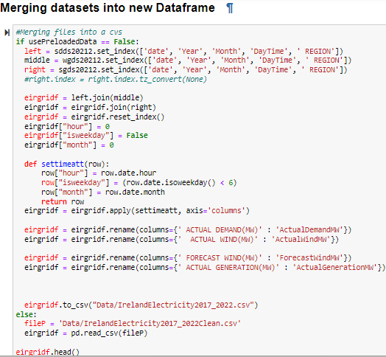
Application: Understanding the Data
Importing, Merging, and exporting Energy Actual and Forecast Generation Data in Python
The data frame's timestep is 15 minutes and it was resampled per hour
Wind Energy Forecasting: Case Study From Ireland
Mentee: Marisely Urdaneta/ Mentor: Silali Banerjee/ Mentor Assistant: Renaisa Wahed

Slide 15
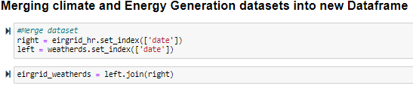
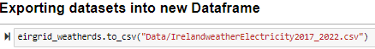
Application: Understanding the Data
Importing, Merging, and exporting Energy Actual and Forecast Generation Data in Python
Wind Energy Forecasting: Case Study From Ireland
Mentee: Marisely Urdaneta/ Mentor: Silali Banerjee/ Mentor Assistant: Renaisa Wahed

Slide 16
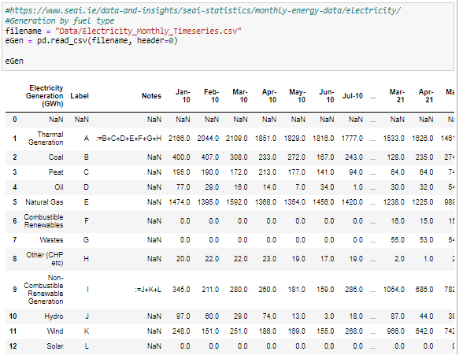
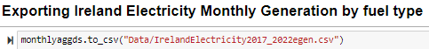
Application: Understanding the Data
Importing, Merging, and exporting Energy Actual and Forecast Generation Data in Python
Wind Energy Forecasting: Case Study From Ireland
Mentee: Marisely Urdaneta/ Mentor: Silali Banerjee/ Mentor Assistant: Renaisa Wahed

Slide 17
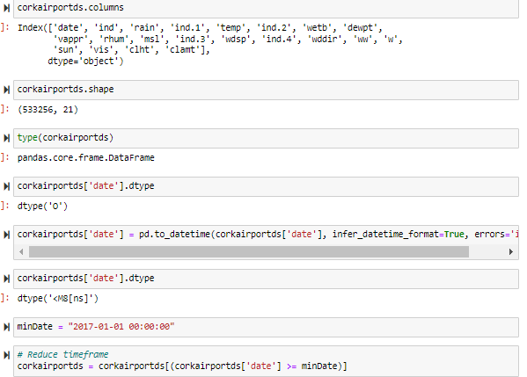
Application: Data Wrangling
Pre-processing Data in Python
Wind Energy Forecasting: Case Study From Ireland
Mentee: Marisely Urdaneta/ Mentor: Silali Banerjee/ Mentor Assistant: Renaisa Wahed

Slide 18
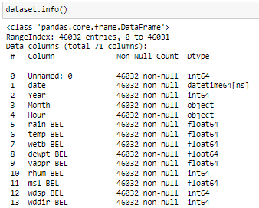
Application: Data Wrangling
Pre-processing Data in Python
Wind Energy Forecasting: Case Study From Ireland
Mentee: Marisely Urdaneta/ Mentor: Silali Banerjee/ Mentor Assistant: Renaisa Wahed

Slide 19
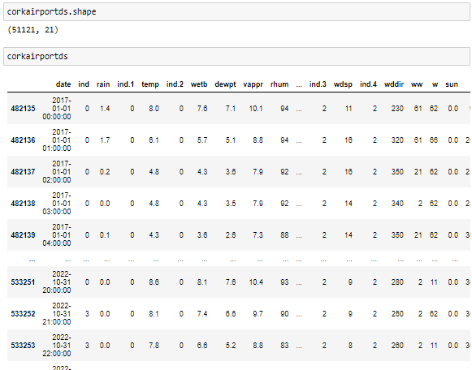
Application: Data Wrangling
Pre-processing Data in Python
Wind Energy Forecasting: Case Study From Ireland
Mentee: Marisely Urdaneta/ Mentor: Silali Banerjee/ Mentor Assistant: Renaisa Wahed

Slide 20
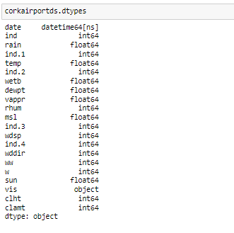
Application: Data Wrangling
Pre-processing Data in Python
It is performed for all datasets before and after merging
Wind Energy Forecasting: Case Study From Ireland
Mentee: Marisely Urdaneta/ Mentor: Silali Banerjee/ Mentor Assistant: Renaisa Wahed

Slide 21
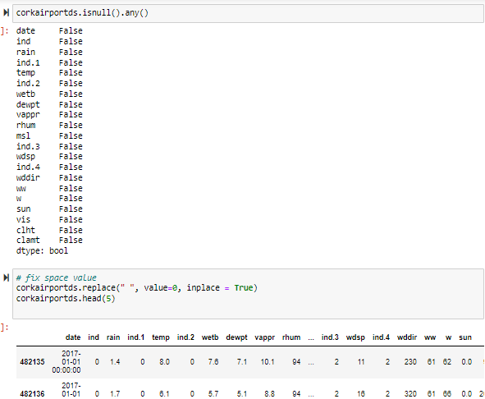
Application: Data Wrangling
Dealing with Missing Values in Python
Wind Energy Forecasting: Case Study From Ireland
Mentee: Marisely Urdaneta/ Mentor: Silali Banerjee/ Mentor Assistant: Renaisa Wahed

Slide 22
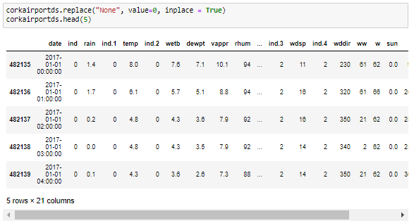
Application: Data Wrangling
Dealing with Missing Values in Python
Wind Energy Forecasting: Case Study From Ireland
Mentee: Marisely Urdaneta/ Mentor: Silali Banerjee/ Mentor Assistant: Renaisa Wahed

Slide 23
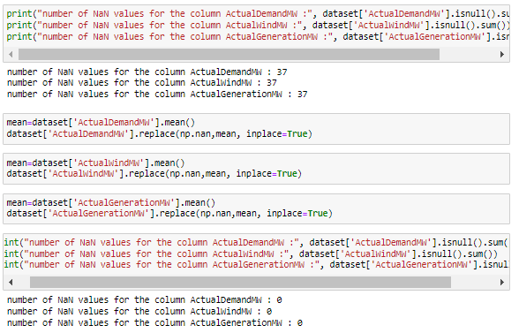
Application: Data Wrangling
Dealing with Missing Values in Python
Wind Energy Forecasting: Case Study From Ireland
Mentee: Marisely Urdaneta/ Mentor: Silali Banerjee/ Mentor Assistant: Renaisa Wahed

Slide 24
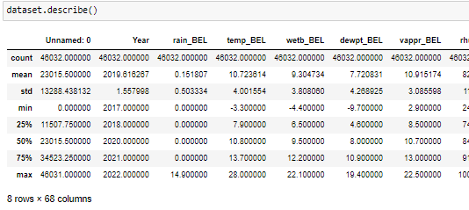
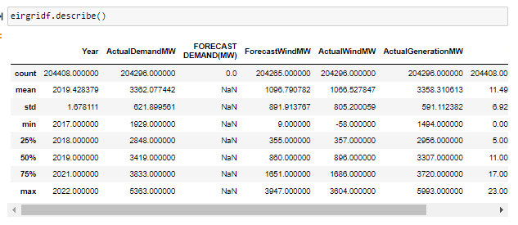
Application: Exploratory Data Analysis (EDA)
Descriptive Statistics
Wind Energy Forecasting: Case Study From Ireland
Mentee: Marisely Urdaneta/ Mentor: Silali Banerjee/ Mentor Assistant: Renaisa Wahed

Slide 25
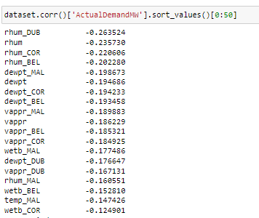
Application: Exploratory Data Analysis (EDA)
Correlation-Statistics
Wind Energy Forecasting: Case Study From Ireland
Mentee: Marisely Urdaneta/ Mentor: Silali Banerjee/ Mentor Assistant: Renaisa Wahed

Slide 26
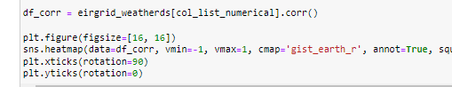
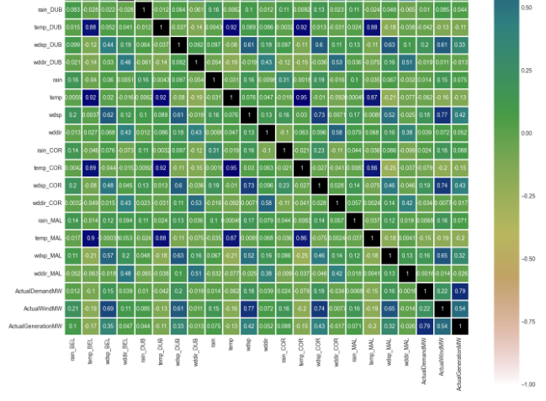
Application: Exploratory Data Analysis (EDA)
Correlation-Statistics
Wind Energy Forecasting: Case Study From Ireland
Mentee: Marisely Urdaneta/ Mentor: Silali Banerjee/ Mentor Assistant: Renaisa Wahed

Slide 27
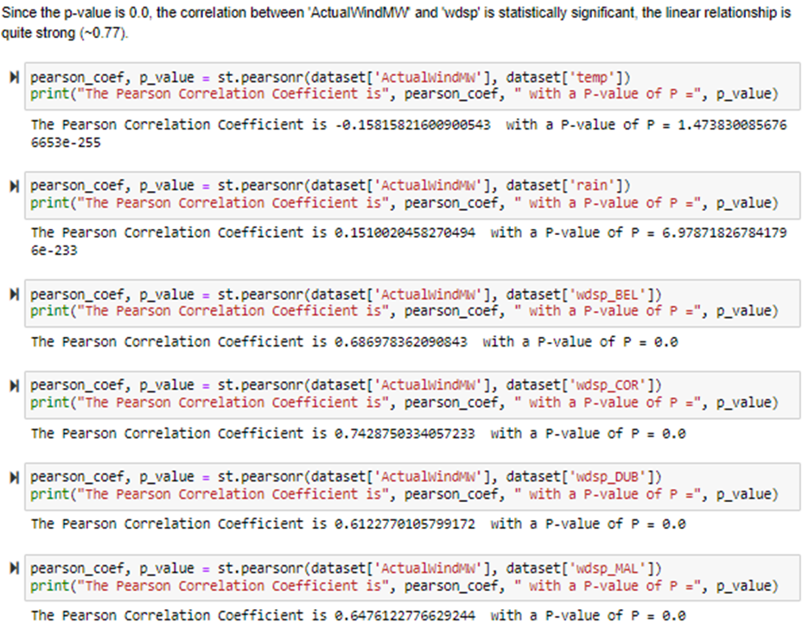
Application: Exploratory Data Analysis (EDA)
Correlation-Statistics
Wind Energy Forecasting: Case Study From Ireland
Mentee: Marisely Urdaneta/ Mentor: Silali Banerjee/ Mentor Assistant: Renaisa Wahed

Slide 28
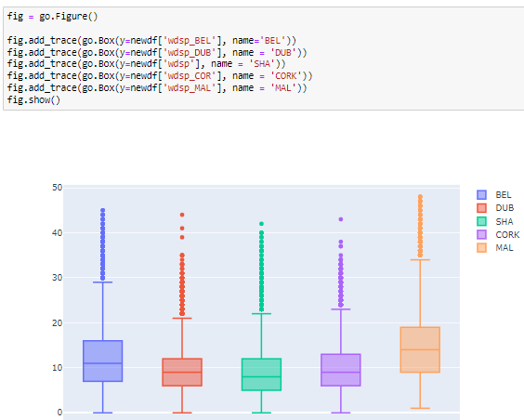
Application: Exploratory Data Analysis (EDA)
Visualization
Wind Energy Forecasting: Case Study From Ireland
Mentee: Marisely Urdaneta/ Mentor: Silali Banerjee/ Mentor Assistant: Renaisa Wahed

Slide 29
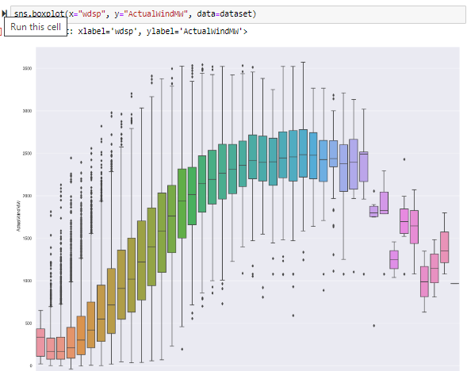
Application: Exploratory Data Analysis (EDA)
Visualization
Wind Energy Forecasting: Case Study From Ireland
Mentee: Marisely Urdaneta/ Mentor: Silali Banerjee/ Mentor Assistant: Renaisa Wahed

Slide 30
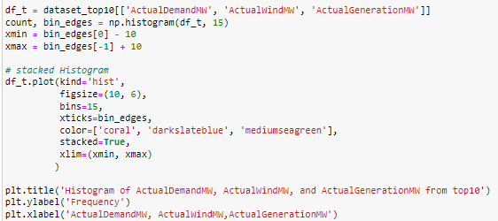
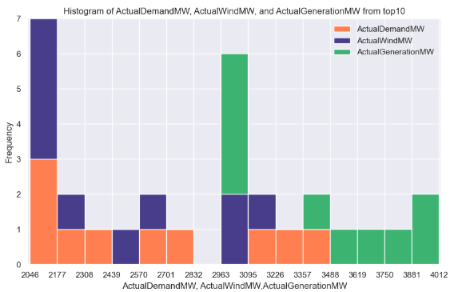
Application: Exploratory Data Analysis (EDA)
Visualization
Wind Energy Forecasting: Case Study From Ireland
Mentee: Marisely Urdaneta/ Mentor: Silali Banerjee/ Mentor Assistant: Renaisa Wahed

Slide 31
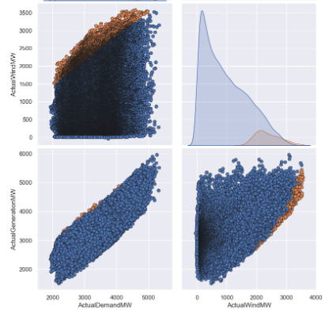
Application: Exploratory Data Analysis (EDA)
Visualization
Wind Energy Forecasting: Case Study From Ireland
Mentee: Marisely Urdaneta/ Mentor: Silali Banerjee/ Mentor Assistant: Renaisa Wahed

Slide 32
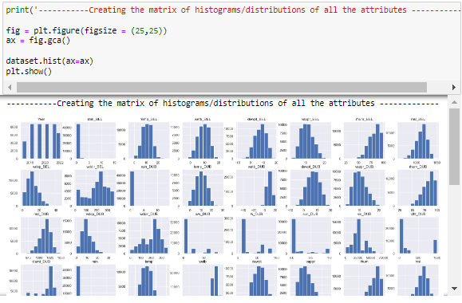
Application: Exploratory Data Analysis (EDA)
Visualization
Wind Energy Forecasting: Case Study From Ireland
Mentee: Marisely Urdaneta/ Mentor: Silali Banerjee/ Mentor Assistant: Renaisa Wahed

Slide 33

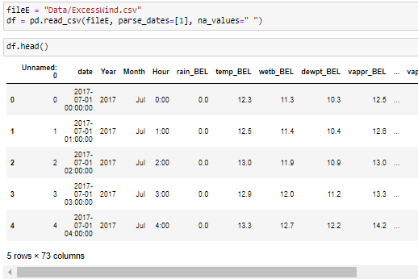
Application: Model: Fitting, Prediction, and Evaluation
ML: Regression Model
Cross-sectional variables
Wind Energy Forecasting: Case Study From Ireland
Mentee: Marisely Urdaneta/ Mentor: Silali Banerjee/ Mentor Assistant: Renaisa Wahed

Slide 34
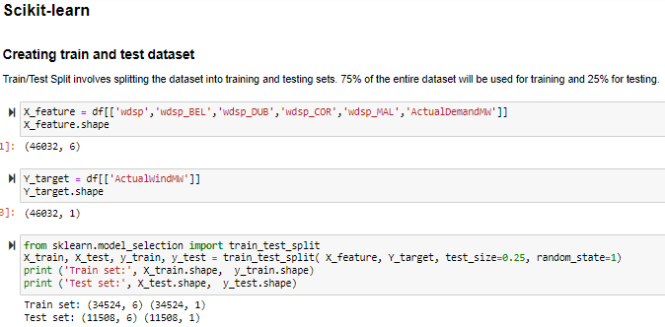
Application: Model: Fitting, Prediction, and Evaluation
ML: Regression Model
Cross-sectional variables
Wind Energy Forecasting: Case Study From Ireland
Mentee: Marisely Urdaneta/ Mentor: Silali Banerjee/ Mentor Assistant: Renaisa Wahed

Slide 35
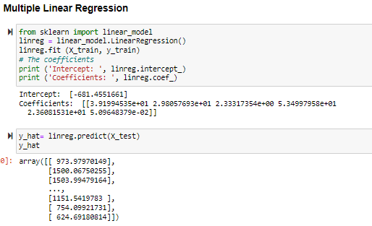
Application: Model: Fitting, Prediction, and Evaluation
ML: Regression Model
Cross-sectional variables
Wind Energy Forecasting: Case Study From Ireland
Mentee: Marisely Urdaneta/ Mentor: Silali Banerjee/ Mentor Assistant: Renaisa Wahed

Slide 36
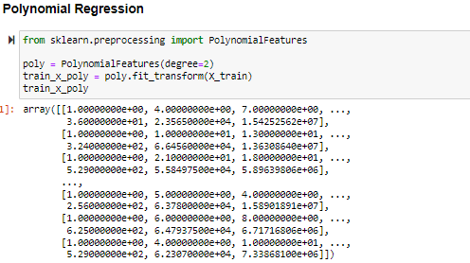
Application: Model: Fitting, Prediction, and Evaluation
ML: Regression Model
Cross-sectional variables
Wind Energy Forecasting: Case Study From Ireland
Mentee: Marisely Urdaneta/ Mentor: Silali Banerjee/ Mentor Assistant: Renaisa Wahed

Slide 37
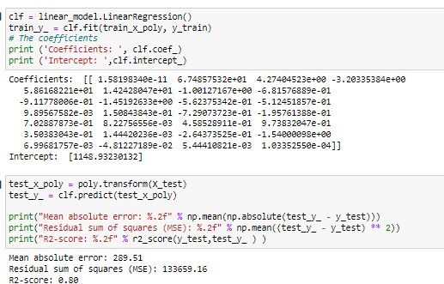
Application: Model: Fitting, Prediction, and Evaluation
ML: Regression Model
Cross-sectional variables
Wind Energy Forecasting: Case Study From Ireland
Mentee: Marisely Urdaneta/ Mentor: Silali Banerjee/ Mentor Assistant: Renaisa Wahed

Slide 38
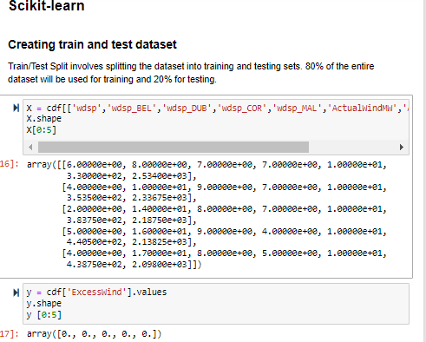
Application: Model: Fitting, Prediction, and Evaluation
ML: Logistic Regression Model
Cross-sectional variables
Wind Energy Forecasting: Case Study From Ireland
Mentee: Marisely Urdaneta/ Mentor: Silali Banerjee/ Mentor Assistant: Renaisa Wahed

Slide 39
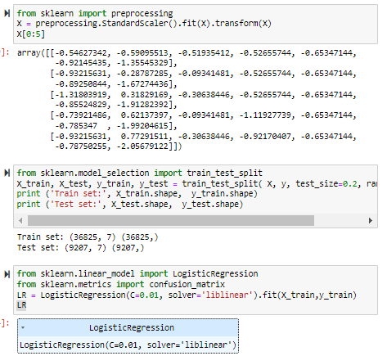
Application: Model: Fitting, Prediction, and Evaluation
ML: Logistic Regression Model
Cross-sectional variables
Wind Energy Forecasting: Case Study From Ireland
Mentee: Marisely Urdaneta/ Mentor: Silali Banerjee/ Mentor Assistant: Renaisa Wahed

Slide 40
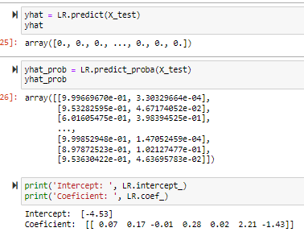
Application: Model: Fitting, Prediction, and Evaluation
ML: Logistic Regression Model
Cross-sectional variables
Wind Energy Forecasting: Case Study From Ireland
Mentee: Marisely Urdaneta/ Mentor: Silali Banerjee/ Mentor Assistant: Renaisa Wahed

Slide 41
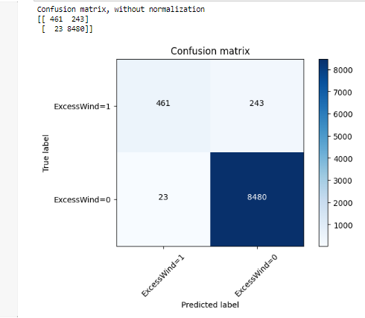
Application: Model: Fitting, Prediction, and Evaluation
ML: Logistic Regression Model
Cross-sectional variables
Wind Energy Forecasting: Case Study From Ireland
Mentee: Marisely Urdaneta/ Mentor: Silali Banerjee/ Mentor Assistant: Renaisa Wahed

Slide 42
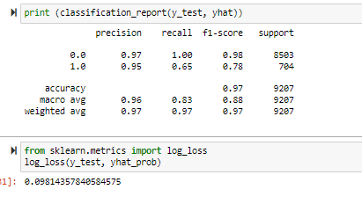
Application: Model: Fitting, Prediction, and Evaluation
ML: Logistic Regression Model
Cross-sectional variables
Wind Energy Forecasting: Case Study From Ireland
Mentee: Marisely Urdaneta/ Mentor: Silali Banerjee/ Mentor Assistant: Renaisa Wahed

Slide 43
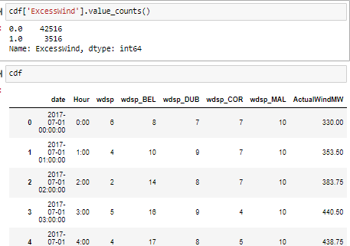
Application: Model: Fitting, Prediction, and Evaluation
ML: KNN Model
Cross-sectional variables
Wind Energy Forecasting: Case Study From Ireland
Mentee: Marisely Urdaneta/ Mentor: Silali Banerjee/ Mentor Assistant: Renaisa Wahed

Slide 44
Application: Model: Fitting, Prediction, and Evaluation
ML: KNN Model
Cross-sectional variables
Wind Energy Forecasting: Case Study From Ireland
Mentee: Marisely Urdaneta/ Mentor: Silali Banerjee/ Mentor Assistant: Renaisa Wahed

Slide 45

Application: Model: Fitting, Prediction, and Evaluation
ML: KNN Model
Cross-sectional variables
Wind Energy Forecasting: Case Study From Ireland
Mentee: Marisely Urdaneta/ Mentor: Silali Banerjee/ Mentor Assistant: Renaisa Wahed

Slide 46

Application: Model: Fitting, Prediction, and Evaluation
ML: KNN Model
Cross-sectional variables
Wind Energy Forecasting: Case Study From Ireland
Mentee: Marisely Urdaneta/ Mentor: Silali Banerjee/ Mentor Assistant: Renaisa Wahed

Slide 47

Application: Model: Fitting, Prediction, and Evaluation
ML: KNN Model
Cross-sectional variables
Wind Energy Forecasting: Case Study From Ireland
Mentee: Marisely Urdaneta/ Mentor: Silali Banerjee/ Mentor Assistant: Renaisa Wahed

Slide 48


Application: Model: Fitting, Prediction, and Evaluation
ML: KNN Model
Cross-sectional variables
Wind Energy Forecasting: Case Study From Ireland
Mentee: Marisely Urdaneta/ Mentor: Silali Banerjee/ Mentor Assistant: Renaisa Wahed

Slide 49

Application: Model: Fitting, Prediction, and Evaluation
ML: Autoregression Model
Time Series Depends on stationarity (Autoregressive, moving average, ARIMA)
Wind Energy Forecasting: Case Study From Ireland
Mentee: Marisely Urdaneta/ Mentor: Silali Banerjee/ Mentor Assistant: Renaisa Wahed

Slide 50

Application: Model: Fitting, Prediction, and Evaluation
ML: Regression Model
Time Series Depends on stationarity (Autoregressive, moving average, ARIMA)
Wind Energy Forecasting: Case Study From Ireland
Mentee: Marisely Urdaneta/ Mentor: Silali Banerjee/ Mentor Assistant: Renaisa Wahed

Slide 51

Application: Model: Fitting, Prediction, and Evaluation
ML: Autoregression Model
Time Series Depends on stationarity (Autoregressive, moving average, ARIMA)
Wind Energy Forecasting: Case Study From Ireland
Mentee: Marisely Urdaneta/ Mentor: Silali Banerjee/ Mentor Assistant: Renaisa Wahed

Slide 52

Application: Model: Fitting, Prediction, and Evaluation
ML: Autoregression Model
Time Series Depends on stationarity (Autoregressive, moving average, ARIMA)
Wind Energy Forecasting: Case Study From Ireland
Mentee: Marisely Urdaneta/ Mentor: Silali Banerjee/ Mentor Assistant: Renaisa Wahed

Slide 53

Application: Model: Fitting, Prediction, and Evaluation
ML: Autoregression Model
Persistence Model
Time Series Depends on stationarity (Autoregressive, moving average, ARIMA)
Wind Energy Forecasting: Case Study From Ireland
Mentee: Marisely Urdaneta/ Mentor: Silali Banerjee/ Mentor Assistant: Renaisa Wahed

Slide 54

Application: Model: Fitting, Prediction, and Evaluation
ML: Autoregression Model
Time Series Depends on stationarity (Autoregressive, moving average, ARIMA)
Wind Energy Forecasting: Case Study From Ireland
Mentee: Marisely Urdaneta/ Mentor: Silali Banerjee/ Mentor Assistant: Renaisa Wahed

Slide 55

Application: Model: Fitting, Prediction, and Evaluation
ML: Autoregression Model
Time Series Depends on stationarity (Autoregressive, moving average, ARIMA)
Wind Energy Forecasting: Case Study From Ireland
Mentee: Marisely Urdaneta/ Mentor: Silali Banerjee/ Mentor Assistant: Renaisa Wahed

Slide 56
Conclusion
Since data was stored in different websites, it was really time consuming. However, most of the data was brilliantly organized.
The length of dataset is 46032, from 2017-2022 where just 3516 exhibited excess wind energy generation.
The correlation between 'ActualWindMW' and 'wdsp' is statistically significant, the linear relationship is quite strong (~0.77).
In Model: Fitting, Prediction, and Evaluation stage, for Cross-sectional variables were implemented three methods which test scores were above 0.7 instead Time Series Depends on stationarity (Autoregressive, moving average, ARIMA) resulting in vague correlation due to lack of stationarity
Wind Energy Forecasting: Case Study From Ireland
Mentee: Marisely Urdaneta/ Mentor: Silali Banerjee/ Mentor Assistant: Renaisa Wahed

